Slide 1
SESE School for Energy and Transport
Sino-European Doctoral School for Sustainability Engineering (SESE) is a non-entity School established by
2 Chinese and 2 European first-class universities: Tongji University, Harbin Institute of Technology (HIT), Karlsruhe Institute of Technology (KIT), and Instituto Superior Técnico (IST) in Lisbon.
Approved in the annual Cluster - SEEEP meeting in September 2013 of the China-EU University Union, held in Germany.
Goals:
Enhance innovation level and quality of doctoral students education
Promote and strengthen the international cooperation of doctoral students and supervisors,
achieve a high level of intercultural competence by international exchange.

Slide 2
SESE School for Energy and Transport
Topic Session Format (since 2016)
Keynote lecture (20 minutes)
Students presentations (5 to 6 students, ~15 min. each)
Panel discussions to identify interdisciplinary topics between the participants, e.g. to address joint projects and global challenges together.
SESE Summer Schools held so far
2014 at Tongji University
2015 at Instituto Superior Técnico
2016 at Harbin Institute of Technology
2017 at Karlsruhe Institute of Technology
2018 at Tongji University
2019 at Instituto Superior Técnico
Notes:
Topic Session Format used in Summer Schools 2016 and 2017.
In 2015, it was 30 min per student.

Slide 3
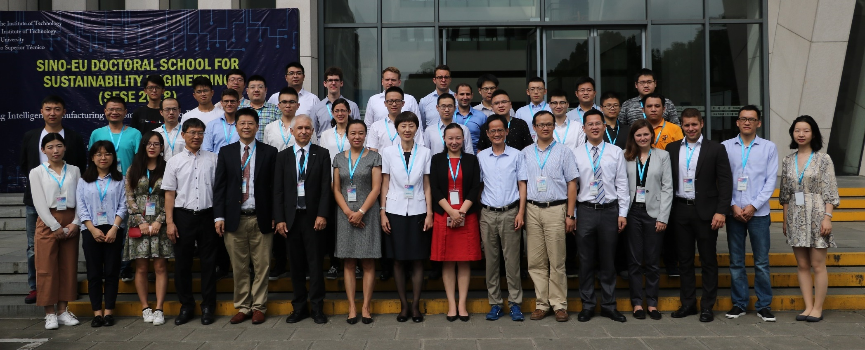
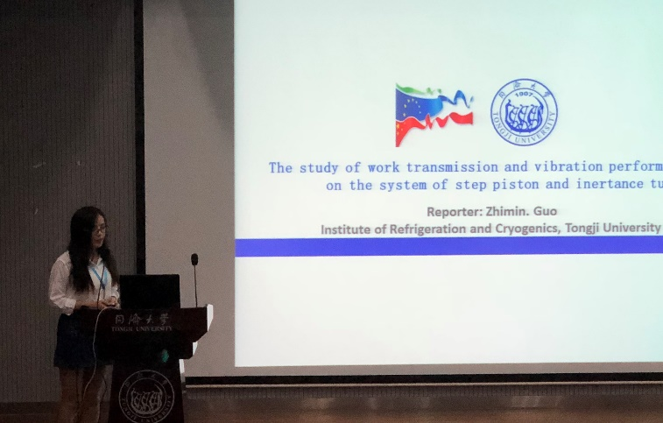
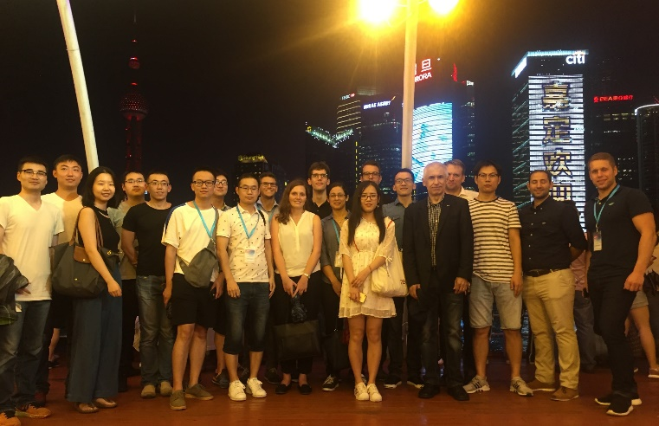
Tongji University 2018
17.09. – 21.09.2018
31 Ph.D. students from KIT, Tongji and HIT
6 keynotes from industry and academia
Social and cultural events
Joint dinners
Laboratory and university tours
Trips to Shanghai city and Nanxiang

Slide 4
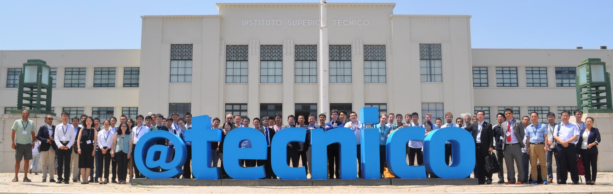
Instituto Superior Técnico 2019
22.07. – 24.07.2019
~70 participants from
KIT, Tongji HIT, IST (SESE Summer School)
IST, KIT, HIT, Shanghai Jiao-Tong (CLUSTER CREAAM programme)
Social and cultural events
Laboratory visits
Joint Dinner

